Slide 1

Prabal Ghosh Côte d'Azur University AIQDSC34 - ECUE More on Deep Learning Algorithms 28/03/2024
https://arxiv.org/abs/2010.11929

Slide 2
Outline
Motivation for Vision Transformer
Vision Transformer architecture
Training Vision Transformer
Result Discussion
Conclusion

Slide 3
Motivation and idea :
The encoder-decoder architecture of Transformer achieved state of the art performance on machine translation tasks , by allowing significantly more parallelization (i.e less time to train).
RestNet (CNN) was the best solution for image classification.
Can we apply Transformers to images and get state-of-the-art results ?
Use the Transformer Encoder architecture with fewest possible modifications and apply on image classification tasks.

Slide 4
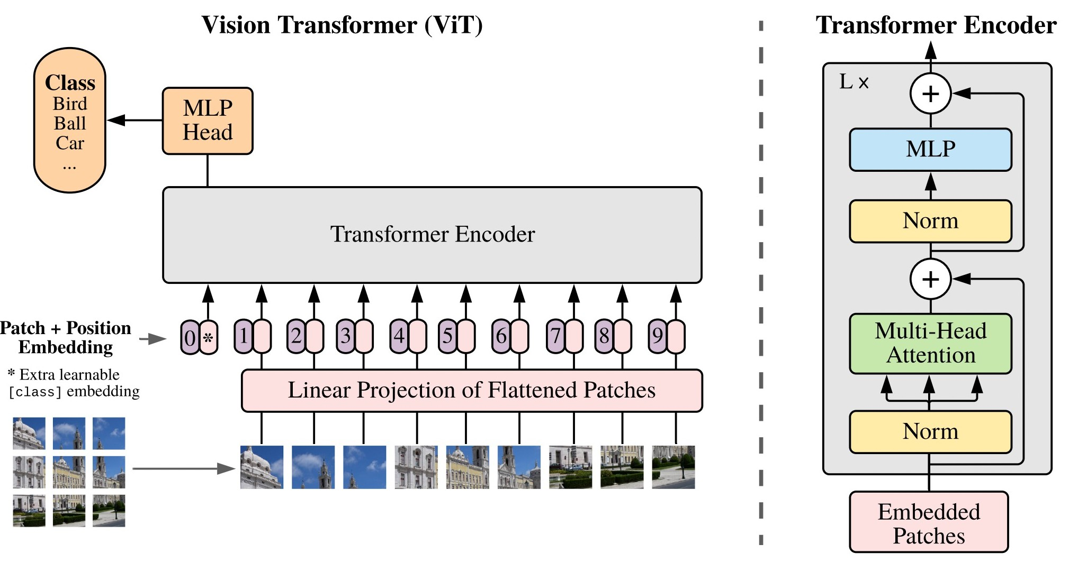
Vision Transformers Architecture: Uses Popular BERT Architecture
Input Patches Instead of Pixels
Dosovitskiy et al. An Image is Worth 16x16 Words: Transformers for Image Recognition at Scale. ICLR 2021.

Slide 5



Standard Transformer on Patches
Dosovitskiy et al, “An Image is Worth 16x16 Words: Transformers for Image Recognition at Scale”, ICLR 2021
Dog image is free for use
Image Ref. http://wangshusen.github.io/

Slide 6









Standard Transformer on Patches
Split Image into Patches
Here, the patches do not overlap.
User specifies:
patch size, e.g., 16×16;
9 input patches, each of shape 3x16x16
Dosovitskiy et al, “An Image is Worth 16x16 Words: Transformers for Image Recognition at Scale”, ICLR 2021
Image Ref. http://wangshusen.github.io/

Slide 7
Vectorization
Vision Transformer Architecture Explained:
If the patches are H×W×C tensors, then the vectors are HWC×1.
𝐱₁
𝐱₂
𝐱₃
𝐱₄
𝐱₅
𝐱₆
𝐱₇
𝐱₈
𝐱₉

Slide 8

𝐳₂ = 𝐖 𝐱₂ + 𝐛
Vision Transformer Architecture Explained:
𝐳₁ = 𝐖 𝐱₁ + 𝐛
Dense
Dense
𝐱₁
𝐱₂
𝐱₃
⋯
𝐱_{𝑛}

Slide 9
Vision Transformer Architecture Explained:
Linear projection to D-dimensional vector
N input patches, each of shape Cx16x16
𝐳₁
𝐳₂
𝐳₃
⋯
𝐳_{𝑛}
⋯
Share Parameters
Dense
Dense
Dense
Dense
𝐱₁
𝐱₂
𝐱₃
⋯
𝐱_{𝑛}

Slide 10
Vision Transformer Architecture Explained:
Add positional embedding: learned D- dim vector per position
1
2
3
𝑛
Positional Embedding:
⋯
𝐳₁
𝐳₂
𝐳₃
⋯
𝐳_{𝑛}
Dense
Dense
Dense
⋯
Dense
𝐱₁
𝐱₂
𝐱₃
⋯
𝐱_{𝑛}

Slide 11
Add positional embedding vectors to 𝐳₁, 𝐳₂, ⋯ , 𝐳_{𝑛}.
Vision Transformer Architecture Explained:
⋯
𝐳₁
𝐳₂
𝐳₃
⋯
𝐳_{𝑛}
Dense
Dense
Dense
⋯
Dense
𝐱₁
𝐱₂
𝐱₃
⋯
𝐱_{𝑛}

Slide 12









Add positional encoding vectors to 𝐳₁, 𝐳₂, ⋯ , 𝐳_{𝑛}. (Why?)
Vision Transformer Architecture Explained:
3% drop in accuracy is observed, if we do not apply positional.
Positional embedding can be 1D or 2D, but no significant improvement is found in using 2D embedding, hence the paper uses 1D position embedding.
①
②
③
① ③
②
𝐳₁ 𝐳₂ 𝐳_{3 ⋯} 𝐳_{𝑛}
Dense Dense Dense ⋯⋯ Dense
^{𝐱}1 ^{𝐱}2 ^{𝐱}3 ⋯ ^{𝐱}𝑛
④
⑤
⑥
④
⑤ ⑥
⑧
⑨
⑦ ⑧
⑨
Image Ref. http://wangshusen.github.io/

Slide 13
𝐜_{𝑛}
Vision Transformer Architecture Explained:
𝐜₀
𝐜₁
𝐜₂
𝐜₃
⋯
Transformer Encoder Network
𝐳₀
𝐳₁
𝐳₂
𝐳₃
⋯
𝐳_{𝑛}
Embed
Dense
Dense
Dense
⋯
Dense
[CLS]
𝐱₁
𝐱₂
𝐱₃
⋯
𝐱_{𝑛}

Slide 14
Vision Transformer Architecture Explained:
MLP head is implemented one hidden layer and tanh as non linearity at pre-training time and by a single linear layer at fine tuning time. For classification task we are just interested in the first context token(C0).
MLP
Head
𝐩
𝐜
0
Class
Transformer Encoder Network
𝐳₀
𝐳₁
𝐳₂
𝐳₃
⋯
𝐳_{𝑛}
Embed
Dense
Dense
Dense
⋯
Dense
[CLS]
𝐱₁
𝐱₂
𝐱₃
⋯
𝐱_{𝑛}

Slide 15
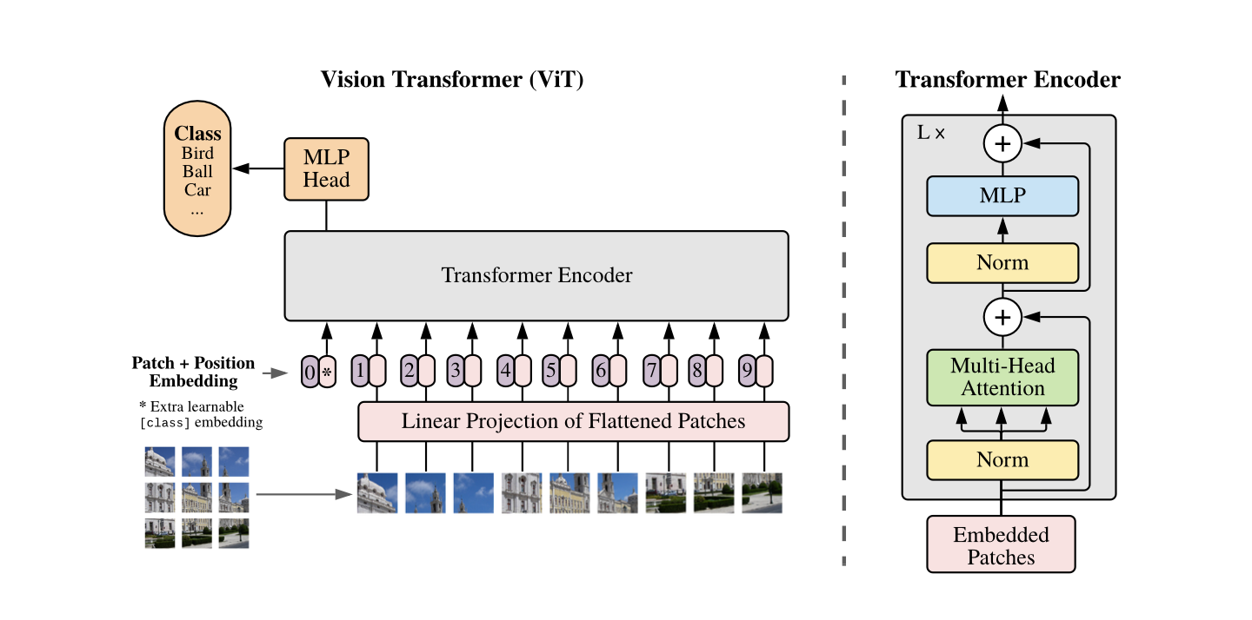
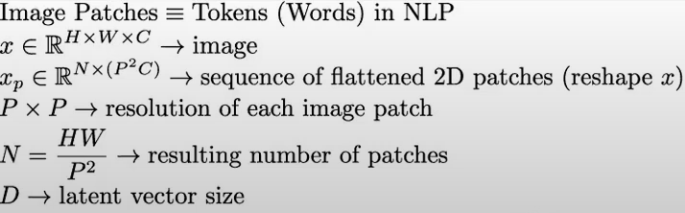
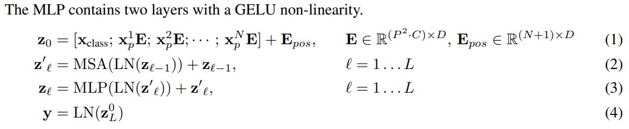
Vision Transformer Architecture

Slide 16
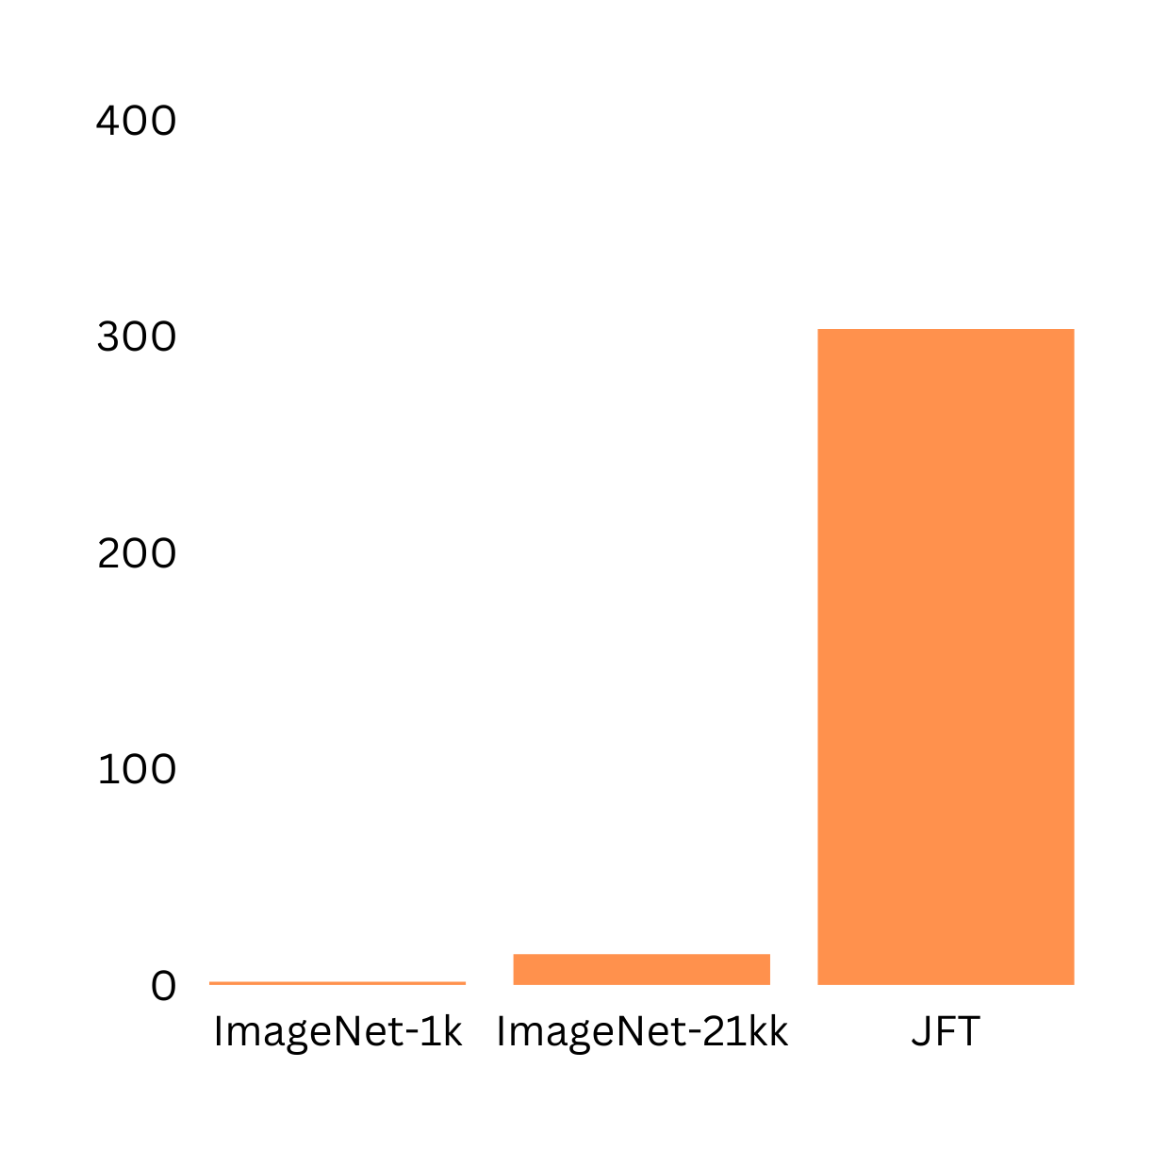
Training Dataset Vision Transformer
Vision Transformer(ViT) was pre-trained on 3 datasets of varying size and scale.
Pre-training datasets
303M
ImageNet-1K: 1.3M images, 1K classes
ImageNet-21k: 14M images, 21K classes
JFT: 303M images, 18K classes
No of images in millions(M)
1.3M
14M
ImageNet-1k and ImageNet-21K are also used for fine-tuning!
Datasets

Slide 17
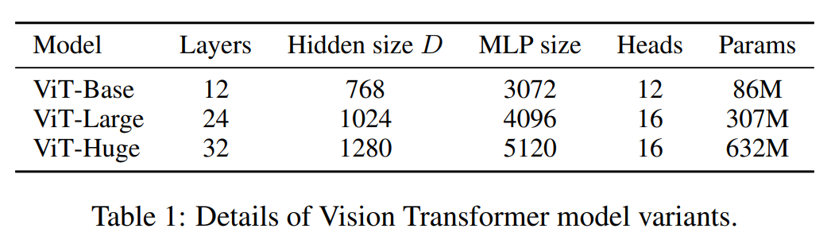
Pre-Training Vision Transformer
Vision Transformer(ViT) was pre-trained with same configurations of as BERT.
All the models are pre-trained using ADAM optimizer with batch size of 4096

Slide 18
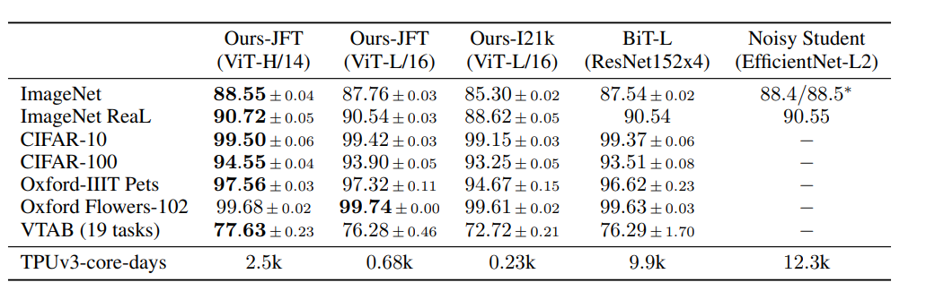
Fine-Tuning Vision Transformer
All the models are fine tuned using SGD optimizer with monentum and batch size of 512 for ViT-L/16 and 518 for ViT-H/14.

Slide 19
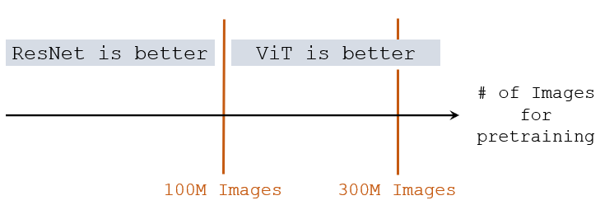
Image Classification Accuracies
Pretrained on ImageNet (small), ViT is slightly worse than ResNet.
Pretrained on ImageNet-21K (medium), ViT is comparable to ResNet.
Pretrained on JFT (large), ViT is slightly better than ResNet.

Slide 20
Self-supervision:
Most of Transformers success in NLP is the result of large-scale self-supervised pre-training where Transformer is trained on massive unlabelled data from the web.
Using masked work prediction technique that were used in BERT(randomly masking words in input sentence), ViT designers also tried the same technique where they masked 50% of patches(masked patch prediction) but achieved less performance than supervised pre-training(79.9% ACC on ImageNet while supervised pre-training is ~85%).
Masked-word prediction in BERT
Masked patch prediction ViT
Transformer is an efficient deep learning architecture
Transformer Encoder
ViT
Transformer is an efficient deep learning architecture

Slide 21
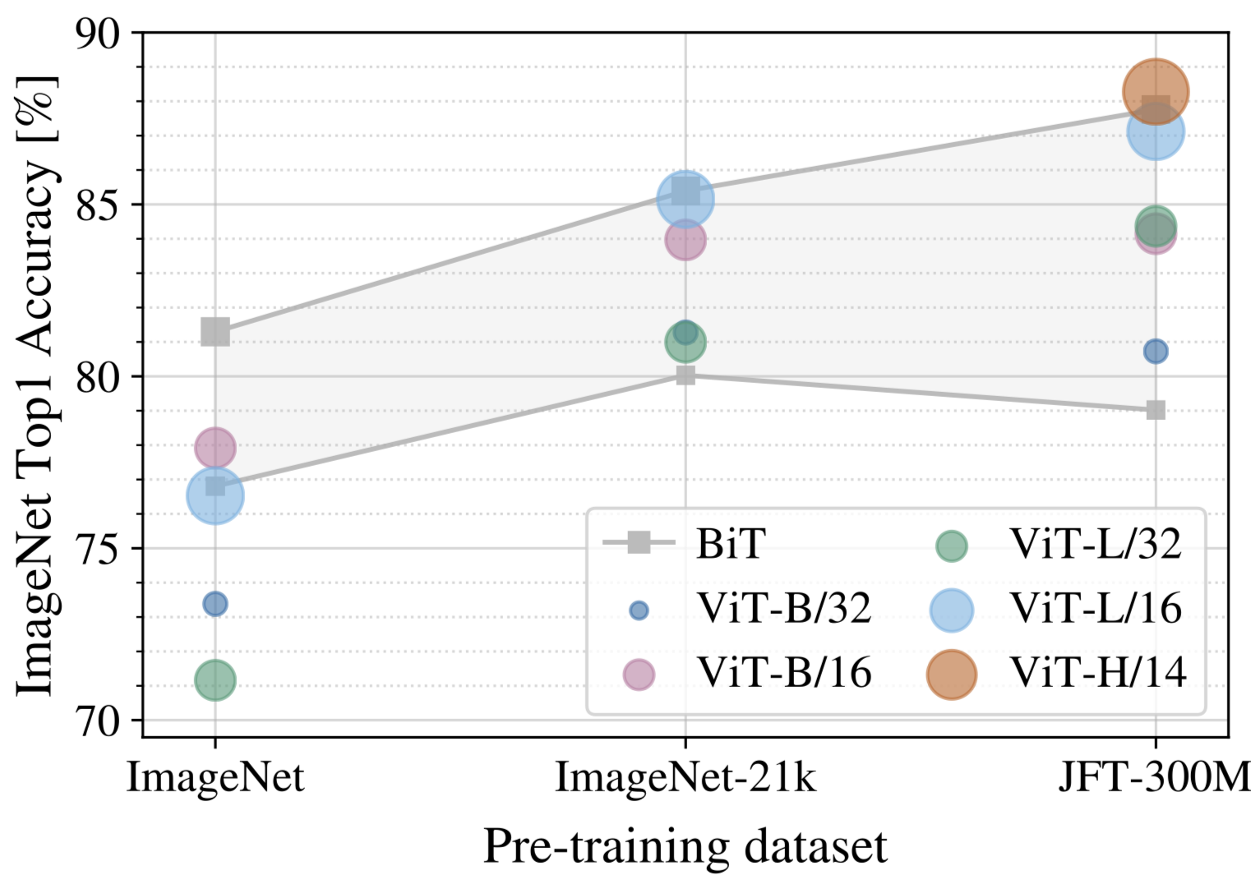
Vision Transformer vs SOTA CNN(ResNet)
Results
On small pre-training dataset(ImageNet-1k, 1.3M images), ResNet performs better than ViT due to CNN inductive biases that compensate for small dataset.
On medium pre-training dataset(Imagenet-21k, 14M images), ViTs and ResNet performance are almost similar although ViTs perform slightly better.
On large pre-training dataset(JFT, 303M images), large ViT outperforms ResNet and show no sign of plateau.
B: Base, L: Large, H: Huge
14, 16, 32: Patch size(the smaller patch size, the more the patches, and the bigger the model) >> N = HW/PP
Ex: ViT-B/16: Base ViT with 16x16 patch size

Slide 22
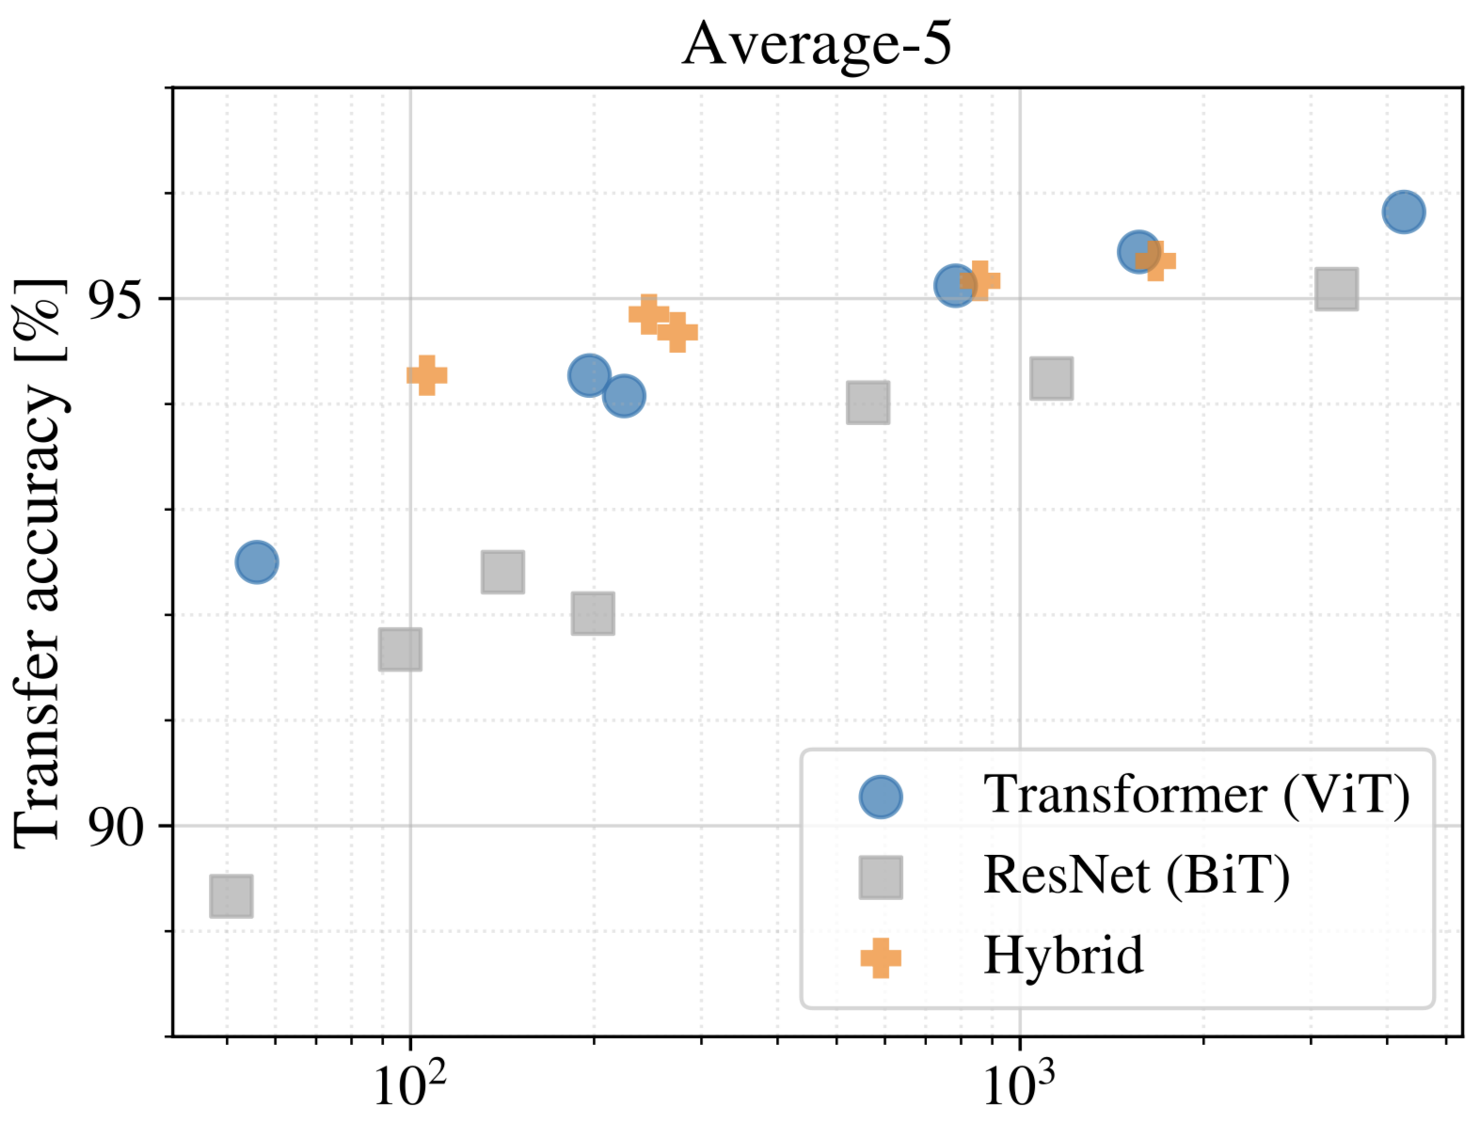
Vision Transformer vs SOTA CNN(ResNet)
Pre-training compute
ViT clearly outperforms ResNet on performance/compute trade-off.
ViT uses approximately 2-4x less compute to achieve the same transfer accuracy(average of all downstream datasets).
Hybrid(CNN+ViT) slightly outperforms ViT on relatively small compute, but vanishes on large compute budget.
ViT shows extreme scaling behavior. Its performance doesn’t seem to saturate for increased compute.
Pre-training compute(in ExaFLOPs)
1 FLOP = 1 multiply-add(wx+b) per second
FLOPs: floating point operations per second

Slide 23
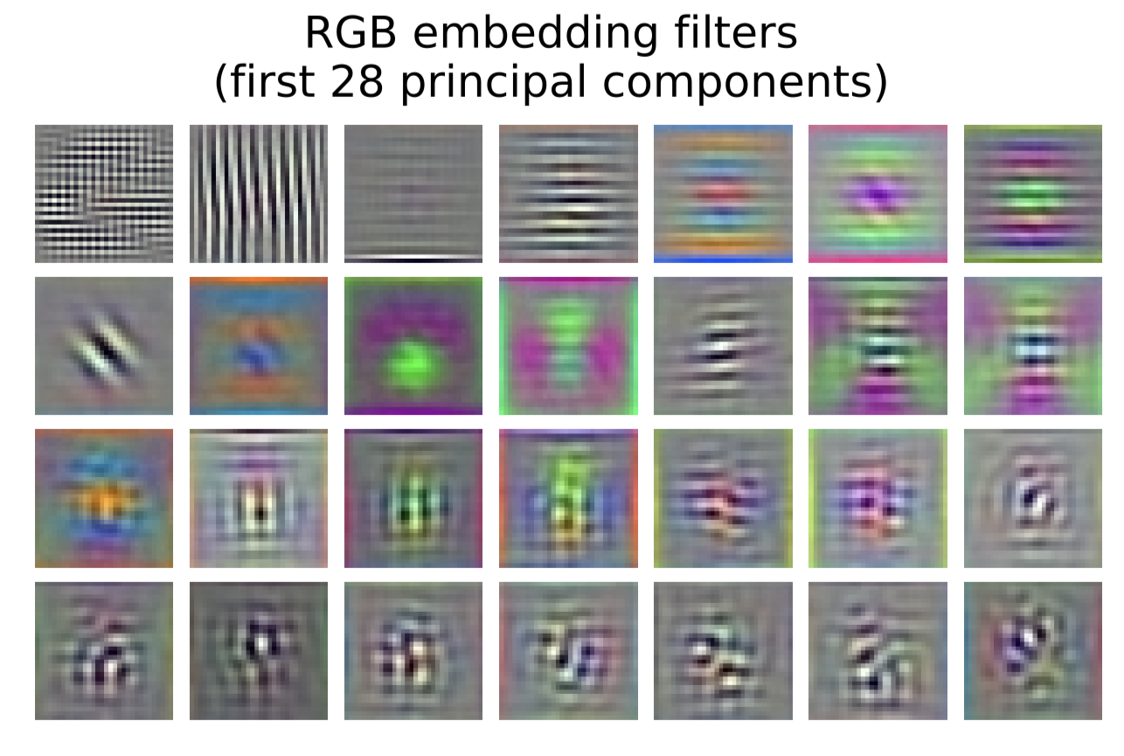
Inspecting ViT Representation
Vision Transformer shows remarkable performance when trained on massive datasets.
The visualized linear embedding of flattened patches shows that the first layer of ViT(linear projection) learns the low level features(such as edges, blobs) of the input image much like ConvNets do!

Slide 24
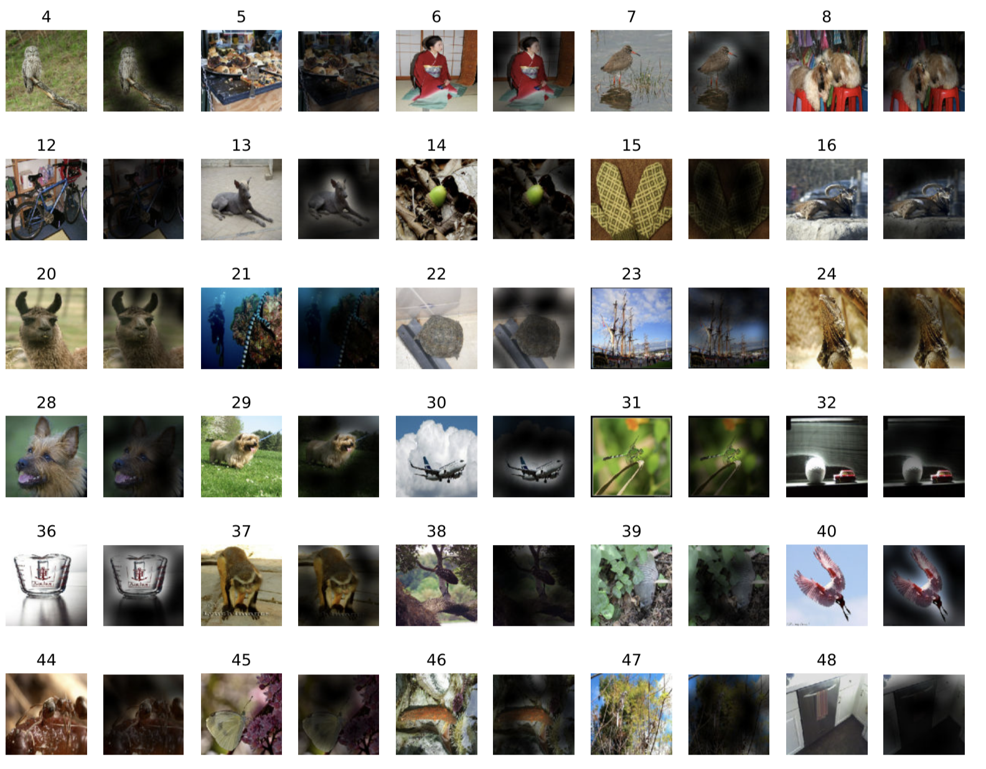

Inspecting ViT Representation
Vision Transformer shows remarkable performance when trained on massive datasets. How does it processes images internally?
On global level, ViT attends to the meaningful part of the image and ignore the rest.

Slide 25
Conclusion
Vison Transformer matches or exceeds the state of art on many image classification datasets, while being relatively cheap to pre-train.
While initial results are encouraging, we need to analyse the performane of ViT on other computer vison tasks, such as detection and segmentation.

Slide 26

Image: Google AI blog

Slide 27
Thank You!

